Slide 1




Barium Tagging in Solid Xenon for nEXO
Tim Walton
PhD Defense
2015-12-08
committee:
William Fairbank Robert Wilson
Bruce Berger Alan Van Orden

Slide 2
Outline
Neutrinos and neutrinoless double beta decay
EXO-200 experiment
nEXO and barium tagging
Barium tagging in solid xenon (SXe):
Spectroscopy of Ba and Ba+ in SXe
Imaging single Ba atoms in SXe

Slide 3
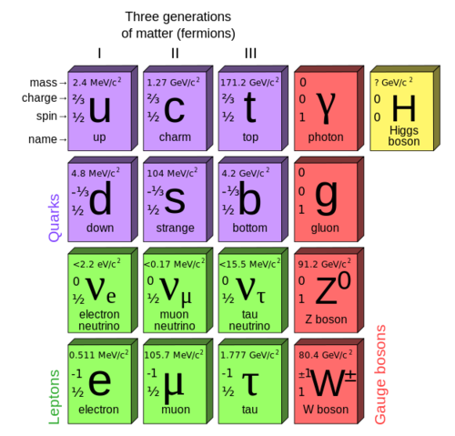
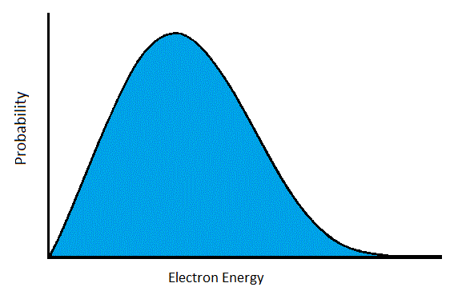
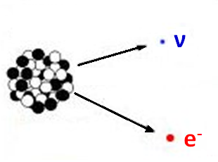
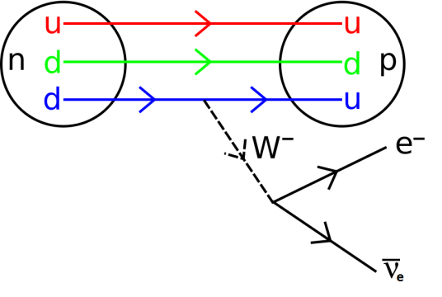
Neutrinos
First indications: beta decay spectrum
Interact only via Weak Force (and Gravity)
Very small mass

Slide 4
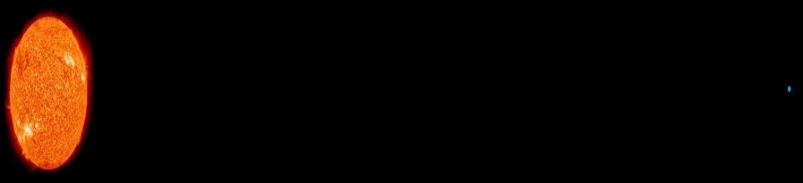
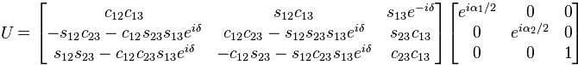
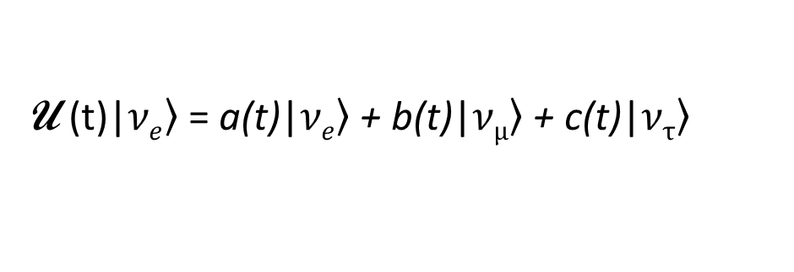
Neutrino oscillation
ν_{e}
ν_{μ}
Neutrino production/interaction happens via flavor (e,μ,τ) states, which are not stationary states:
U (t)|$\left.νe\right\rangle$ = a(t)|$\left.νe\right\rangle$ + b(t)|$\left.νμ\right\rangle$ + c(t)|$\left.ντ\right\rangle$
Very small ν mass
Hamiltonian can be written in terms of mass squared differences:
∆m_{ij}² = m_{i}² - m_{j}²
Stationary states are called “mass states”
Mixing matrix which transforms between flavor/mass bases:
s_{ij} = sin θ_{ij}, c_{ij} = cos θ_{ij}
Oscillations are sensitive to these mixing matrix parameters, as well as ∆m_{ij}²

Slide 5
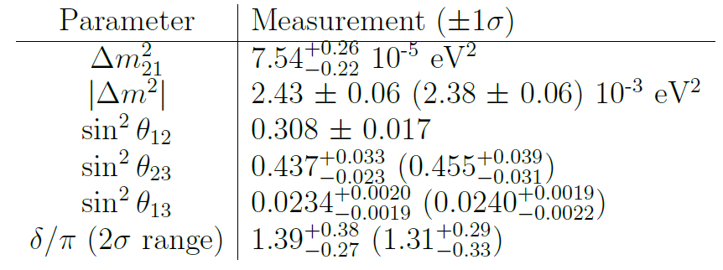
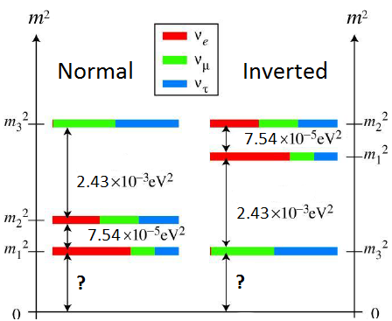
Neutrino oscillation
ν_{e}
ν_{μ}
Neutrino mixing measurements given Normal (Inverted) Hierarchy:
Neutrino Mass Hierarchy
2012 Review by K. Nakamura, U. Tokyo, S.T. Petcov

Slide 6
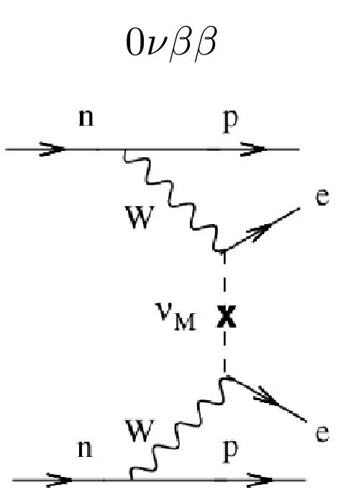
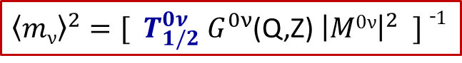
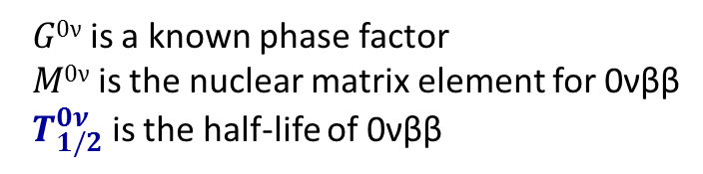
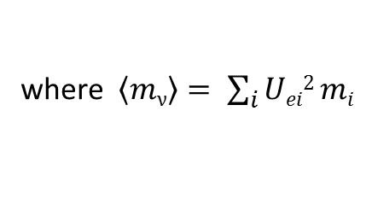
Much yet to learn…
What is the fundamental nature of neutrinos? (How is their mass generated, and why is it so small? Are they Majorana or Dirac particles?)
What is the absolute mass scale of the neutrinos?
Do they violate CP and/or Lepton Number conservation?
A method: search for Neutrinoless Double Beta Decay (0νββ)
Observation of this decay would:
prove that neutrinos are Majorana fermions
measure absolute neutrino mass in the form of effective electron-neutrino mass:
${\left\langle mν\right\rangle }^{2}=[{ T}_{1/2}^{0ν}{ G}_{}^{0ν}$(Q,Z) ${\left|M0ν\right|}^{2} ] ¯1$
where $\left\langle mν\right\rangle = \sum_{i}{Uei2 mi}$
$G0ν$ is a known phase factor
$M0ν$ is the nuclear matrix element for 0νββ
${ T}_{1/2}^{0ν}$ is the half-life of 0νββ

Slide 7
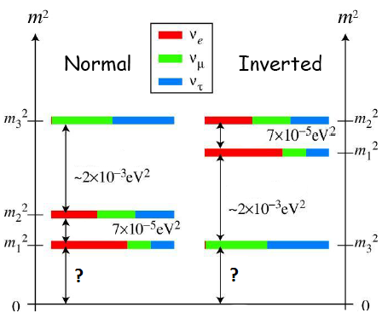
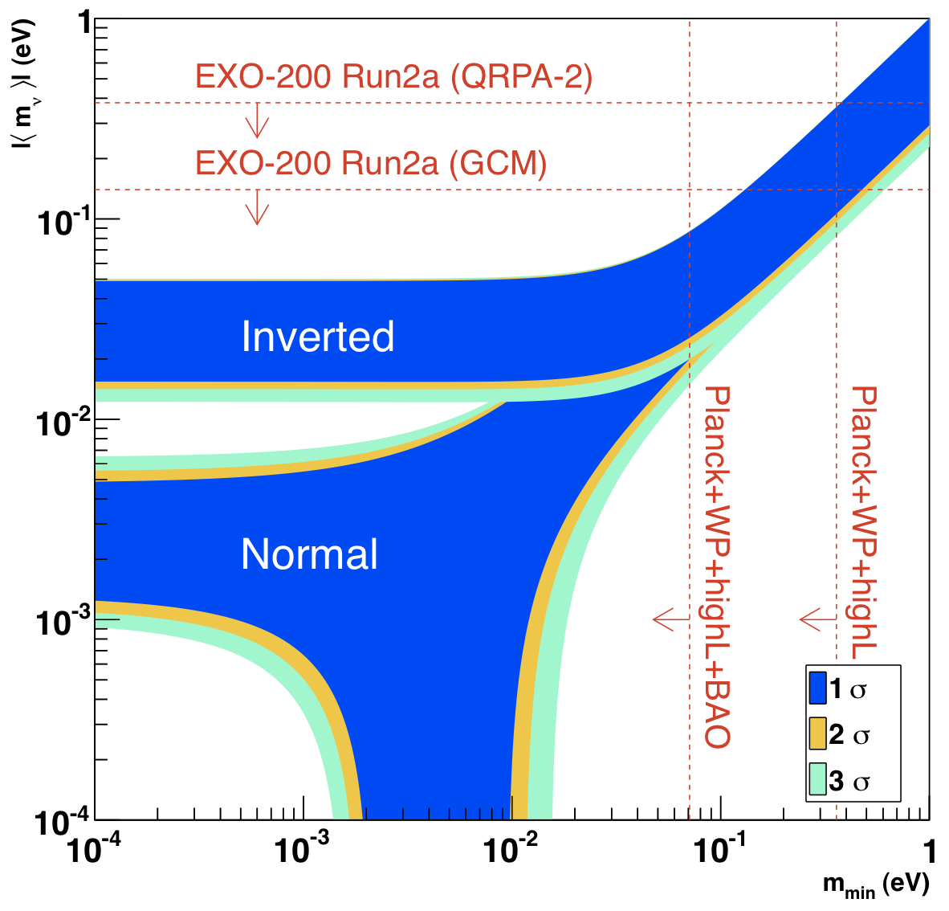
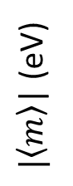
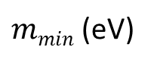
0νββ sensitivity to
hierarchy type:
$|\left\langle m\right\rangle$| (eV)
$mmin$ (eV)

Slide 8
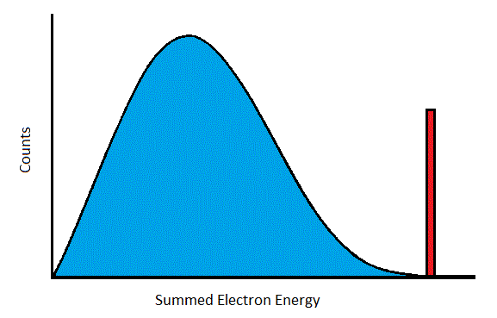
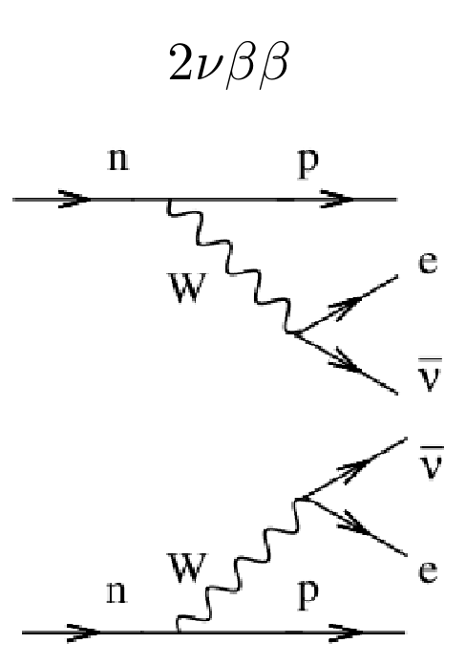
Search for 0νββ
Energy Spectrum Signature
- Predicted by Standard Model
- Observed in many isotopes,
including Xe¹³⁶ in EXO
and KamLAND ZEN
Very rare decay
Very low backgrounds are required

Slide 9
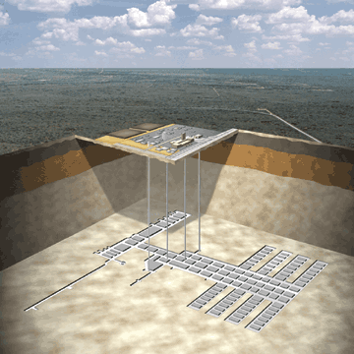
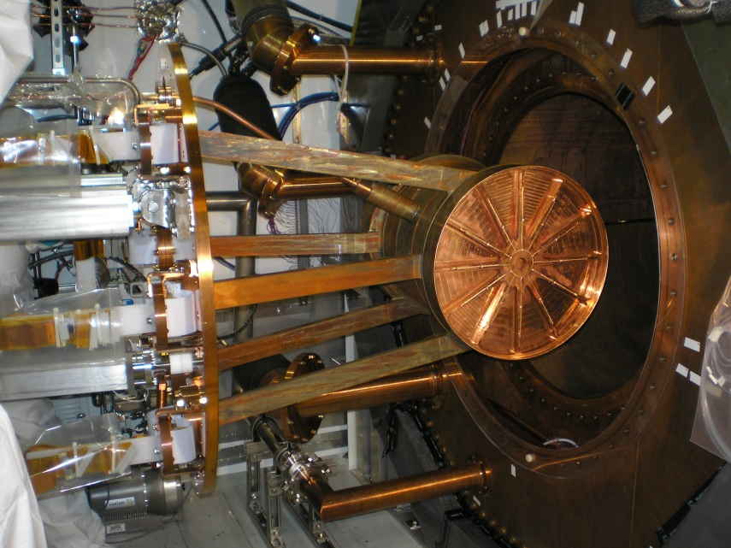
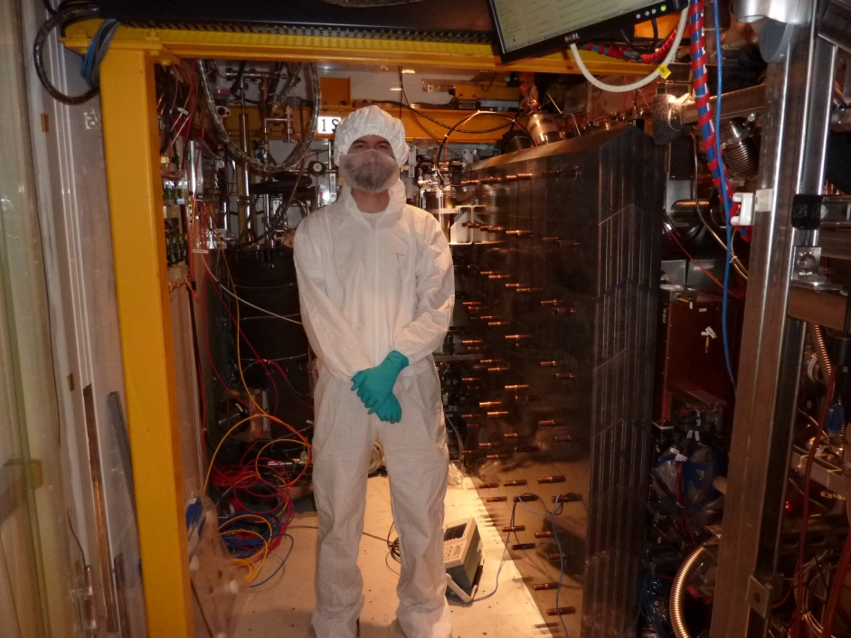
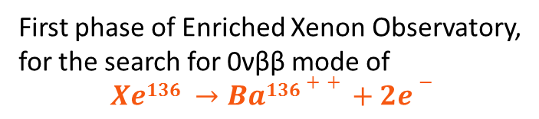
EXO-200:
WIPP salt mine
near Carlsbad, NM
First phase of Enriched Xenon Observatory,
for the search for 0νββ mode of
$$Xe136 →Ba136++ +2e−$$
~200-kg. liquid Xe (LXe) time projection chamber (TPC), enriched to ~80.6% Xe¹³⁶
operates in class 100 cleanroom, 2,150 ft. underground
TPC installation into copper cryostat

Slide 10
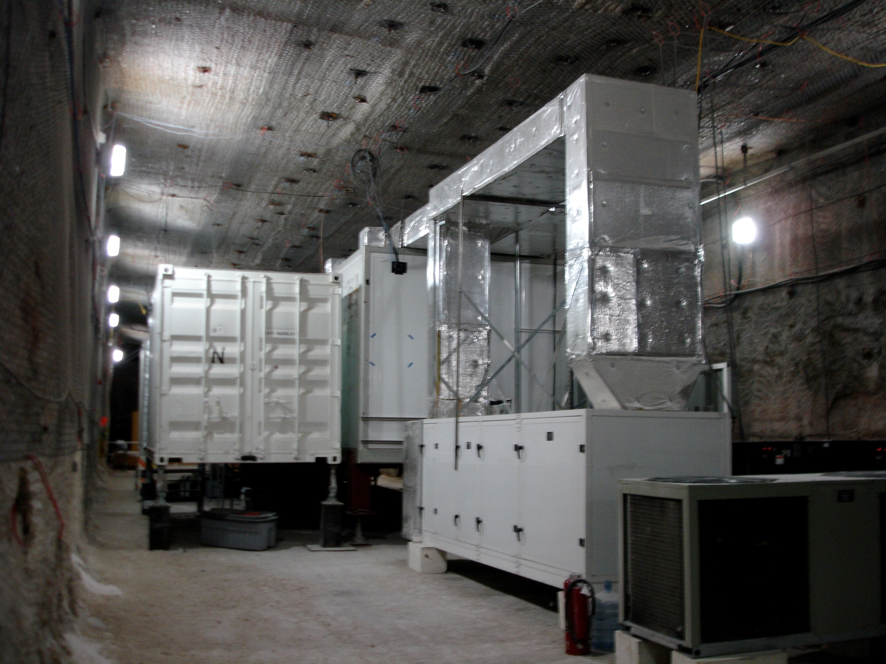
Outside the cleanrooms in the WIPP underground
cleanrooms

Slide 11
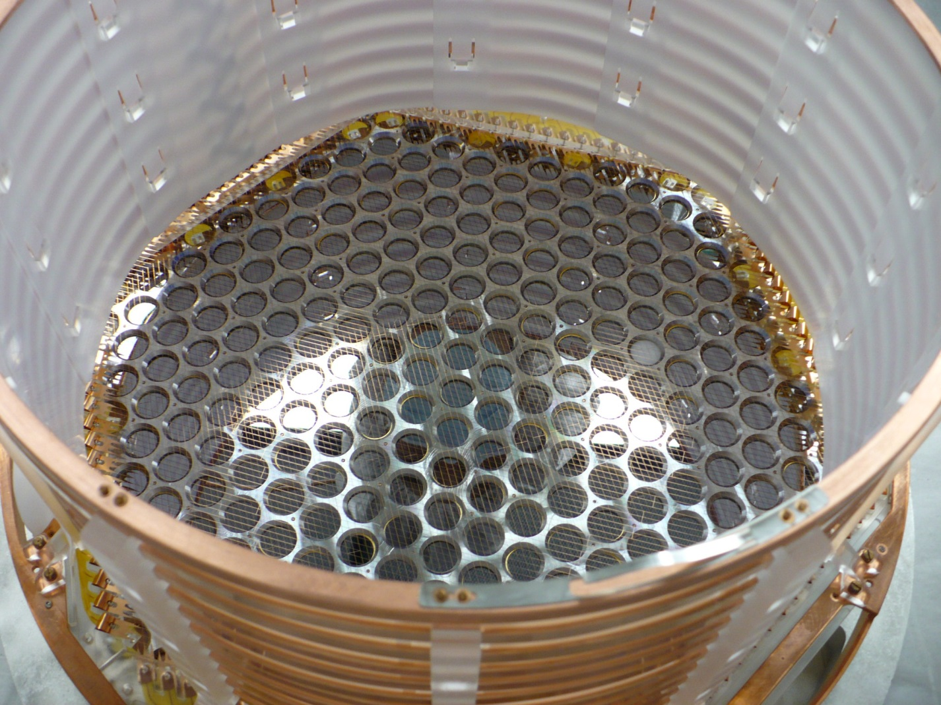
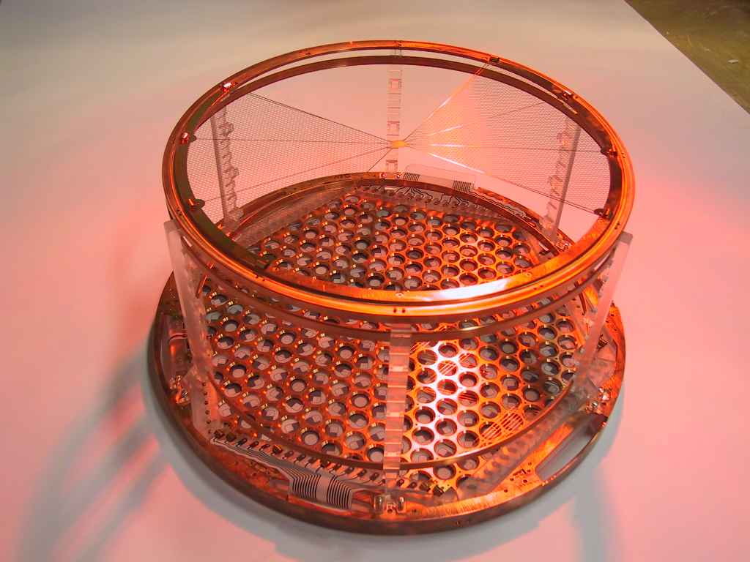
EXO-200 Time Projection Chamber
Cathode grid
Detection plane for
charge (wires) and scintillation
(APDs) from decay events in the LXe

Slide 12
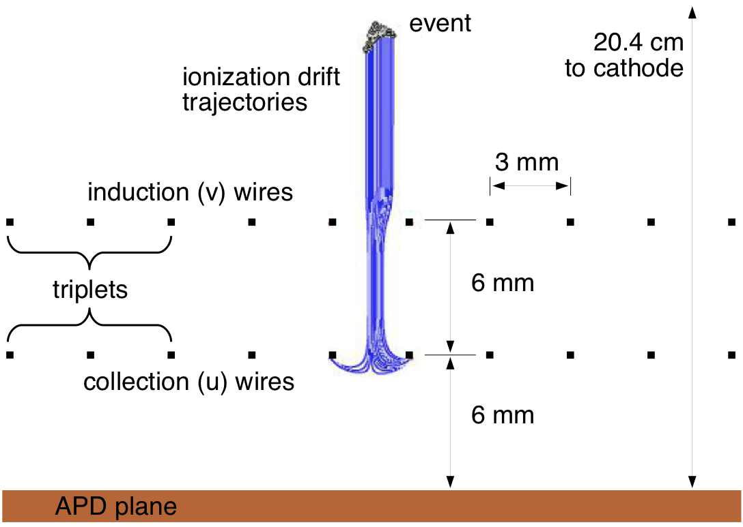
EXO-200 Time Projection Chamber
Liquid Xenon
Cross-hatched “u” and “v” wires give x-y position, u-wires collect ionized charge
Avalanche Photo Diodes (APDs) for scintillation light
Drift time gives z-position
(time between scintillation and charge detection)

Slide 13
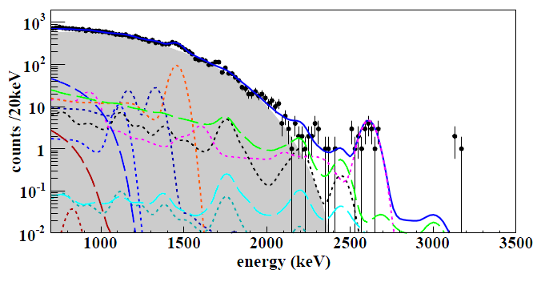
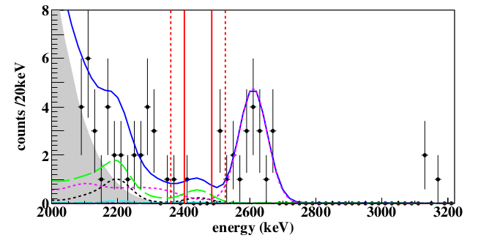
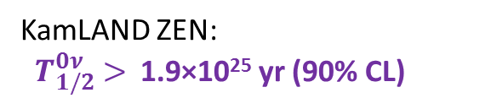
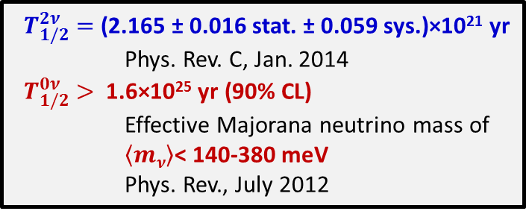
EXO-200 Results
2νββ spectrum
${ T}_{1/2}^{2ν} =$(2.165 ± 0.016 stat. ± 0.059 sys.)×10²¹ yr
Phys. Rev. C, Jan. 2014
${ T}_{1/2}^{0ν} >$1.6×10²⁵ yr (90% CL)
Effective Majorana neutrino mass of
$\left\langle mν\right\rangle$< 140-380 meV
Phys. Rev., July 2012
KamLAND ZEN:
${ T}_{1/2}^{0ν} >$1.9×10²⁵ yr (90% CL)
Zoom into region of interest
(where 0νββ peak would be)

Slide 14







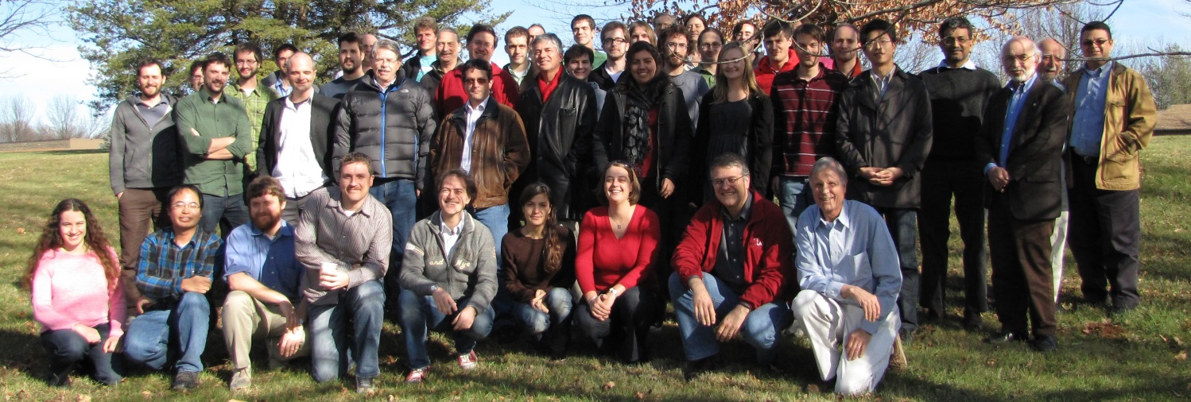

The EXO
Collaboration
University of Alabama, Tuscaloosa AL, USA - D. Auty, T. Didberidze, M. Hughes, A. Piepke, R. Tsang
University of Bern, Switzerland - S. Delaquis, G. Giroux, R. Gornea, T. Tolba, J-L. Vuilleumier
California Institute of Technology, Pasadena CA, USA - P. Vogel
Carleton University, Ottawa ON, Canada - V. Basque, M. Dunford, K. Graham, C. Hargrove, R. Killick, T. Koffas, F. Leonard, C. Licciardi, M.P. Rozo, D. Sinclair
Colorado State University, Fort Collins CO, USA - C. Benitez-Medina, C. Chambers, A. Craycraft, W. Fairbank, Jr., T. Walton
Drexel University, Philadelphia PA, USA - M.J. Dolinski, M.J. Jewell, Y.H. Lin, E. Smith
Duke University, Durham NC, USA – P.S. Barbeau
IHEP Beijing, People’s Republic of China - G. Cao, X. Jiang, L. Wen, Y. Zhao
University of Illinois, Urbana-Champaign IL, USA - D. Beck, M. Coon, J. Ling, M. Tarka, J. Walton, L. Yang
Indiana University, Bloomington IN, USA - J. Albert, S. Daugherty, T. Johnson, L.J. Kaufman
University of California, Irvine, Irvine CA, USA - M. Moe
ITEP Moscow, Russia - D. Akimov, I. Alexandrov, V. Belov, A. Burenkov, M. Danilov, A. Dolgolenko, A. Karelin, A. Kovalenko, A. Kuchenkov, V. Stekhanov, O. Zeldovich
Laurentian University, Sudbury ON, Canada - B. Cleveland, J. Farine, B. Mong, U. Wichoski
University of Maryland, College Park MD, USA - C. Davis, A. Dobi, C. Hall, S. Slutsky, Y-R. Yen
University of Massachusetts, Amherst MA, USA - T. Daniels, S. Johnston, K. Kumar, A. Pocar, D. Shy, J.D. Wright
University of Seoul, South Korea - D.S. Leonard
SLAC National Accelerator Laboratory, Menlo Park CA, USA - M. Breidenbach, R. Conley, A. Dragone, K. Fouts, R. Herbst, S. Herrin, A. Johnson, R. MacLellan, K. Nishimura, A. Odian, C.Y. Prescott, P.C. Rowson, J.J. Russell, K. Skarpaas, M. Swift, A. Waite, M. Wittgen
Stanford University, Stanford CA, USA - J. Bonatt, T. Brunner, J. Chaves, J. Davis, R. DeVoe, D. Fudenberg, G. Gratta, S.Kravitz, D. Moore, I. Ostrovskiy, A. Rivas, A. Schubert, D. Tosi, K. Twelker, M. Weber
Technical University of Munich, Garching, Germany - W. Feldmeier, P. Fierlinger, M. Marino
TRIUMF, Vancouver BC, Canada – J. Dilling, R. Krucken, F. Retière, V. Strickland

Slide 15
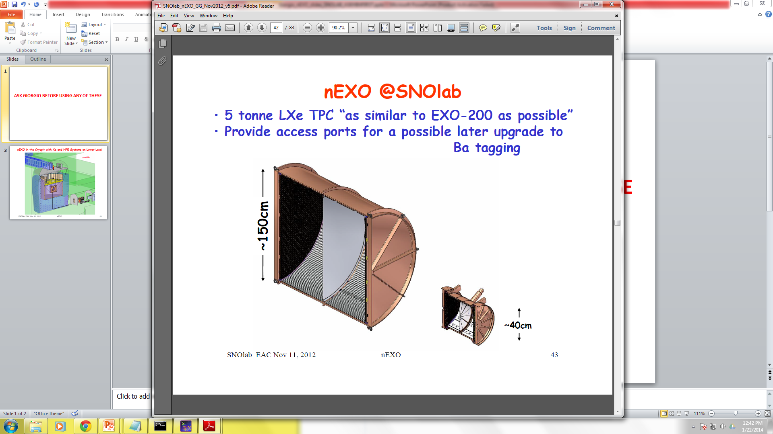
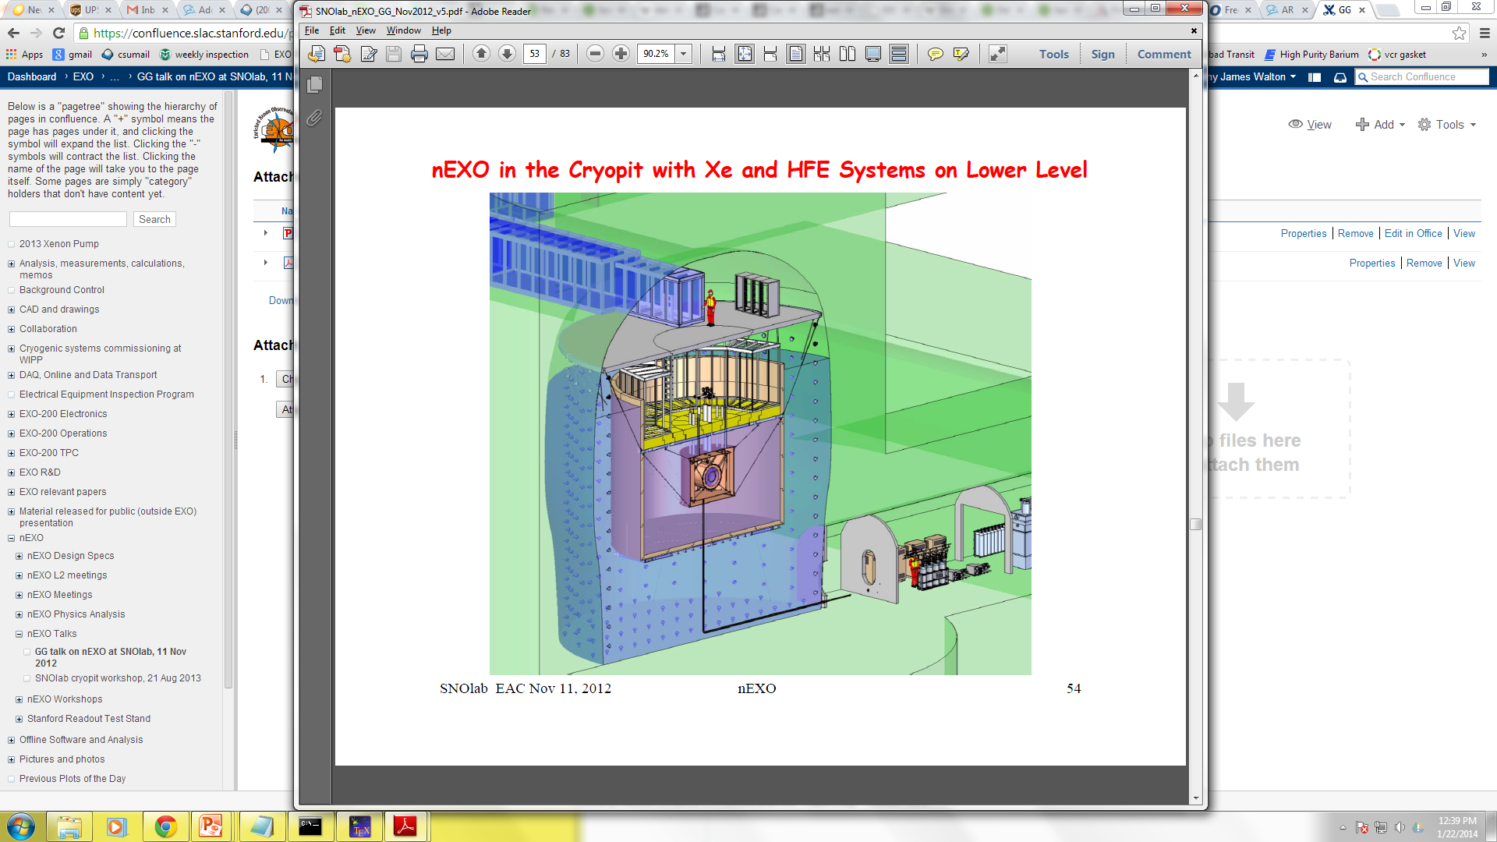

nEXO
the next phase of the EXO experiment
ton-scale LXe TPC for more sensitive search for 0νββ
Barium Tagging: identify barium daughter for complete background elimination
EXO-200
$$Xe136 →Ba136++ +2e−$$
Will require grabbing/detecting a single Ba⁺ out of a macroscopic volume of LXe!

Slide 16
Projected Majorana Mass Sensitivities
Final EXO-200
nEXO 5-yr.
nEXO 10-yr. w/ Ba-tag
info from Giorgio Gratta, Aug. 2013

Slide 17
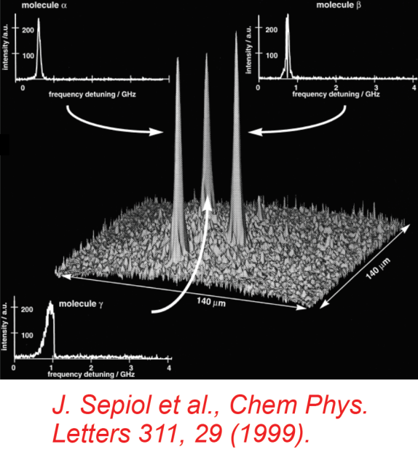
Barium Tagging in Solid Xenon
Optical fiber
w/ excitation
laser
Cold Probe
CCD
Image of 3 dye molecules in SXe:
Solid
Xenon
Ba⁺
Liquid Xenon
Solid
Xenon
Ba⁺

Slide 18
Barium Tagging in Solid Xenon
Requires:
Position of 2β decay known (TPC)
Understanding of Ba/Ba⁺ fluorescence in solid xenon
Detection sensitivity at single atom/ion level

Slide 19
Barium Tagging in Solid Xenon
Requires:
Position of 2β decay known (TPC)
Understanding of Ba/Ba+ fluorescence in solid xenon
Detection sensitivity at single atom/ion level

Slide 20
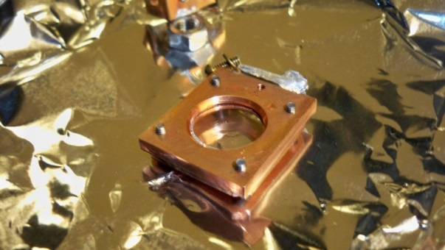
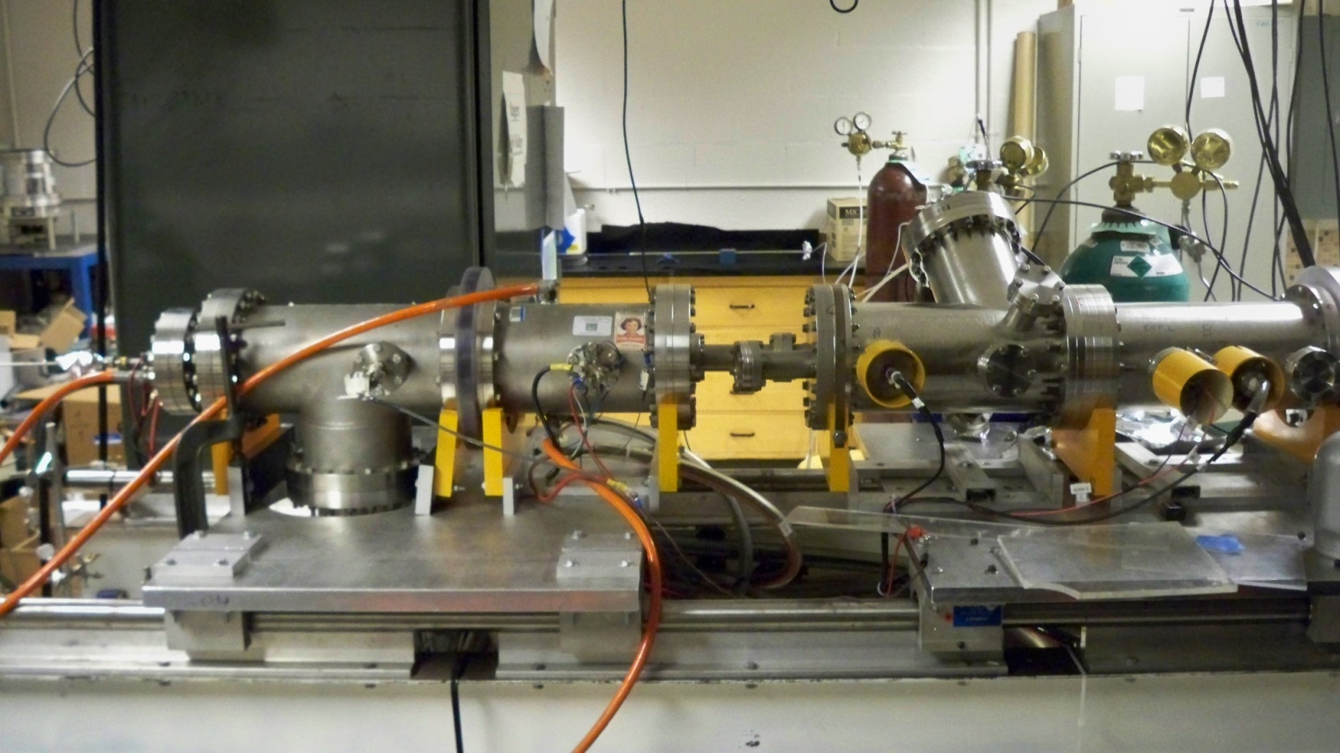
Ion Beam
for depositing Ba⁺ ions into Solid Xenon
Ba⁺ ion
source
2000 V
EхB
mass filter
pulsing
plates
Sapphire
Window
Faraday cup
Faraday cup
Decelerator
deflection
plates
deflection
plates
deflection
plates
Einzel Lens
Acceleration/
Einzel Lens
Einzel Lens
induction plates

Slide 21
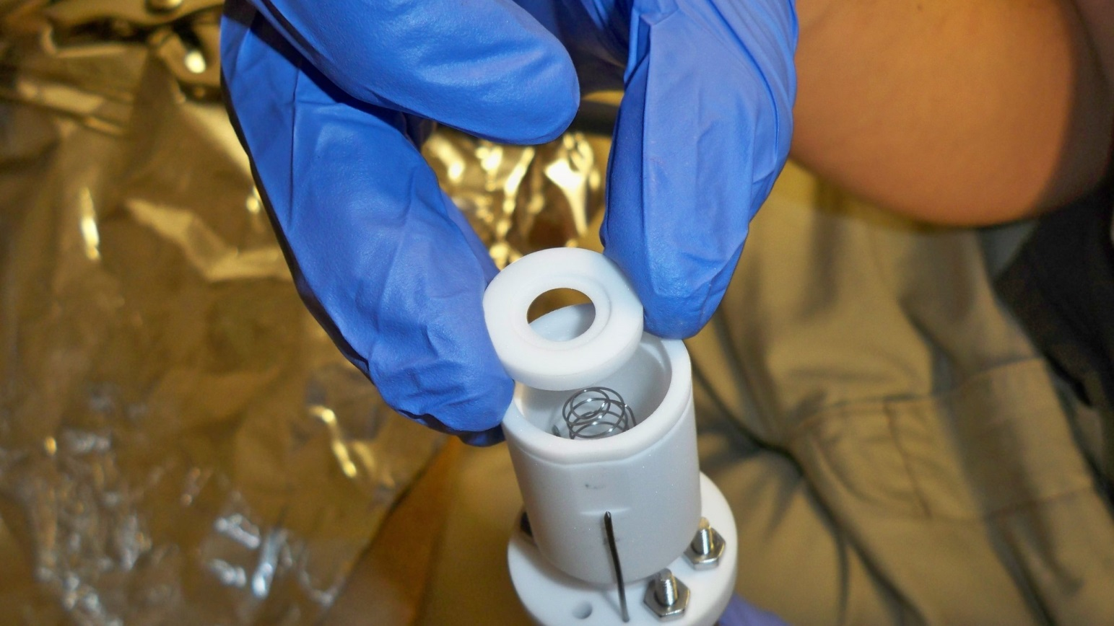
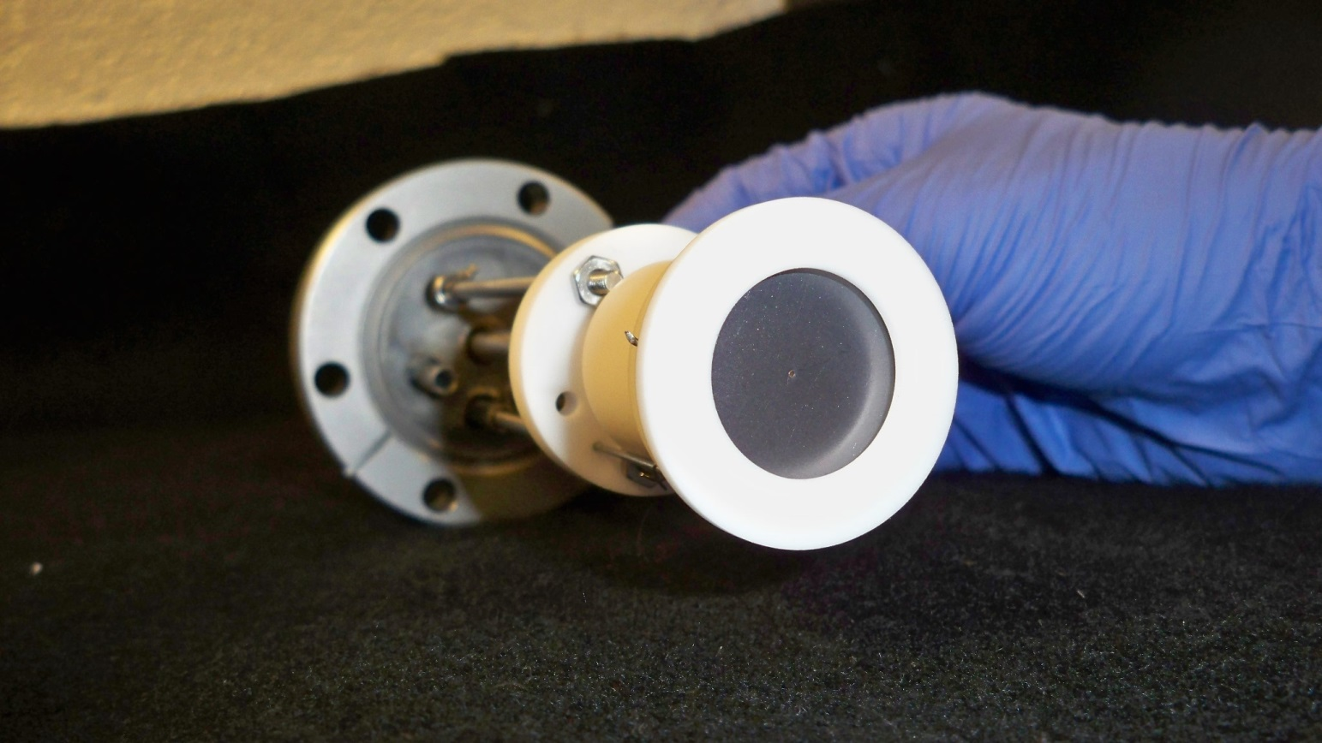
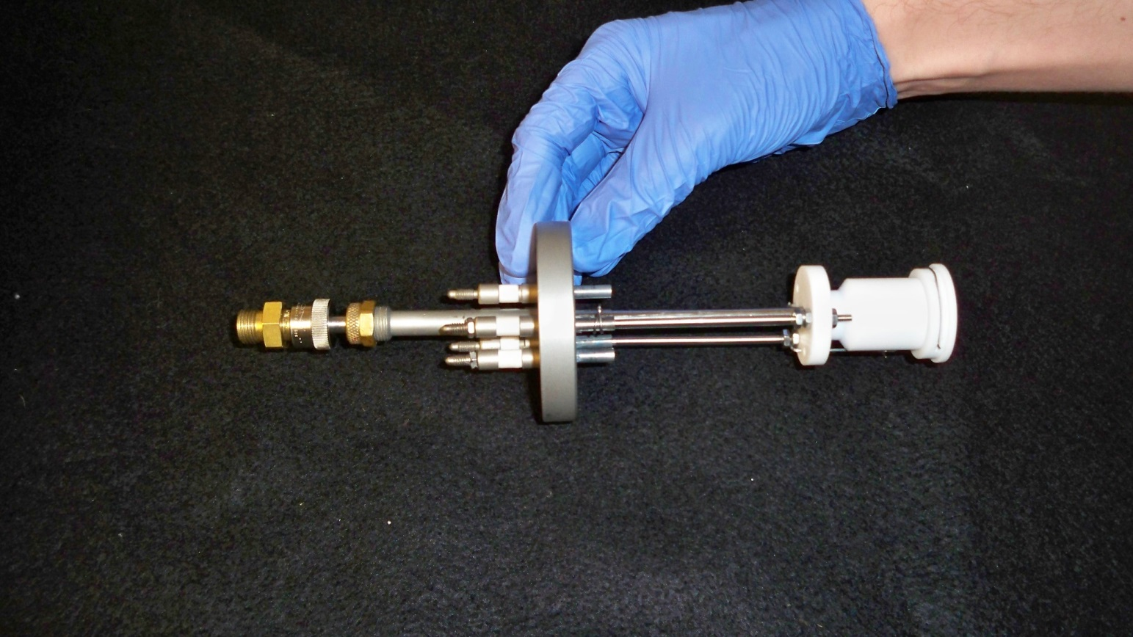
Ion Source
hot filament/cathode
Barium source
anode

Slide 22
Ion Source
Ba⁺ ions escape through small hole
Barium source

Slide 23
Ion Acceleration
2000 V
0 V

Slide 24
E x B Mass Filter for selecting Ba⁺
N
Only ions with velocity satisfying
qE = qvB
will move through filter undeflected, thus selecting specific m/q, which have different velocities due to initial acceleration.
ion beam
Electrode “shims” for shaping E-field
-
+
S

Slide 25


Ba⁺ Ion Deposition
Before deposit: Measure ion current
Ba⁺ Ion Beam
Faraday cup
Sapphire window at 10K
Ammeter

Slide 26
Ba⁺ Ion Deposition
Xe gas
10 K
Ba⁺ Ion Beam
Some neutralization of Ba⁺ to Ba

Slide 27
Ba⁺ Ion Deposition
After deposit: Measure ion current
10 K
Ba⁺ Ion Beam
Faraday cup
Ammeter

Slide 28
Detection
To spectrometer/CCD
filters
555nm
excitation laser

Slide 29
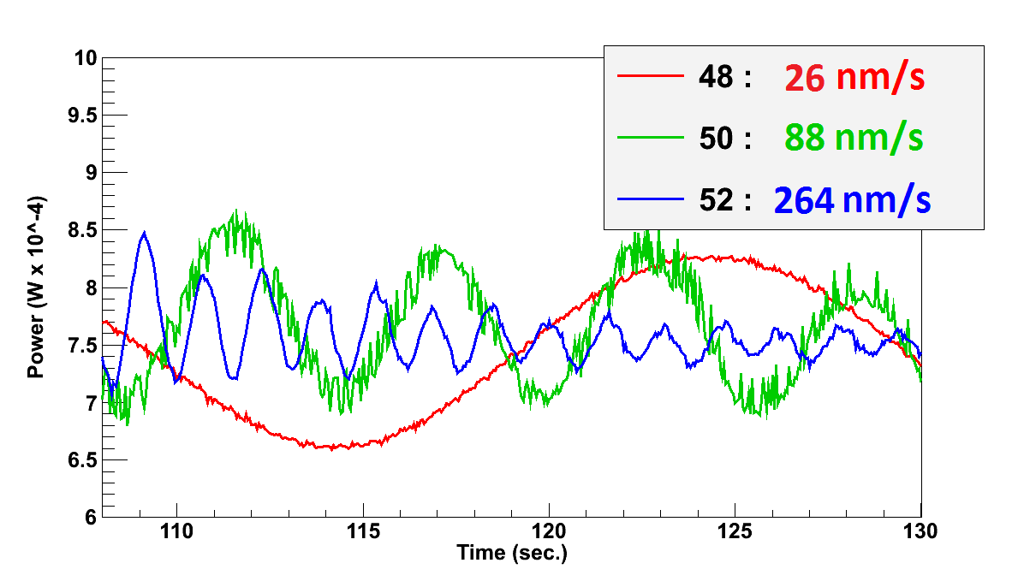
Measuring Xe matrix growth rate using interference fringes:
Xenon
Matrix
Power
Meter
Growth
Leak Valve Setting
Laser

Slide 30
Ba/Ba⁺ vacuum transitions
Ba
Ba⁺
6s6p ¹P₁
6p ²P_{3/2}
6p ²P_{1/2}
1107.6 nm
614.2 nm
1500.0 nm
553.5 nm
1130.3 nm
455.5 nm
5d ²D_{5/2}
6s5d ¹D₂
649.7 nm
5d ²D_{3/2}
6s5d ³D_{1,2}
493.4 nm
6s² ¹S₀
6s ²S_{1/2}
585.4 nm
~1 in 330 decays from ¹P₁ state are into metastable D states
~1 in 4 decays from ²P_{1/2} state are into metastable D state

Slide 31
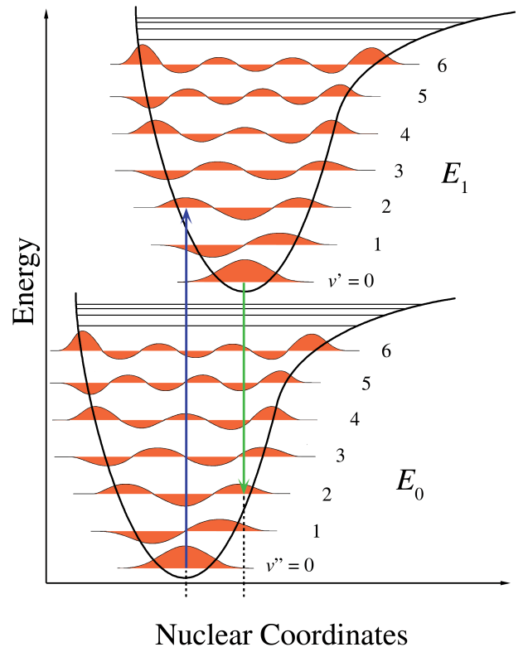
Barium in vacuum
Interactions with neighboring host atoms (xenon)
6s6p ¹P₁
553.5 nm
6s5d ¹D₂
6s5d ³D_{1,2}
6s² ¹S₀
Van Der Waals Forces
Induced dipole-dipole between nearby atoms (or ion w/ nearby atom).
Franck-Condon Principle
Changes in vibrational states can cause shifts between excitation and fluorescence, as well as broadening:
Crossing of these energy curves can lead to significant non-radiative decay channels.

Slide 32
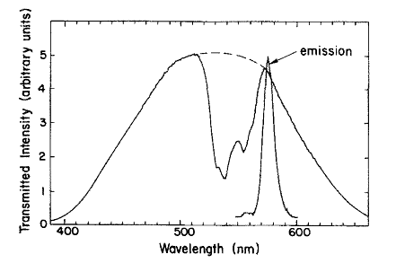
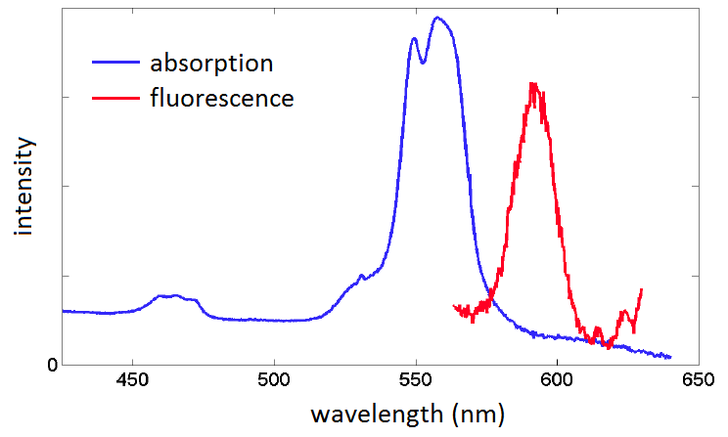
Interactions with neighboring host atoms (xenon)
In general,
Excitation is broadened
Fluorescence is shifted and broadened
Example:
Barium in solid Argon
Barium in solid Xenon
* L. Balling and J. Wright
* measured in Brian Mong’s thesis

Slide 33
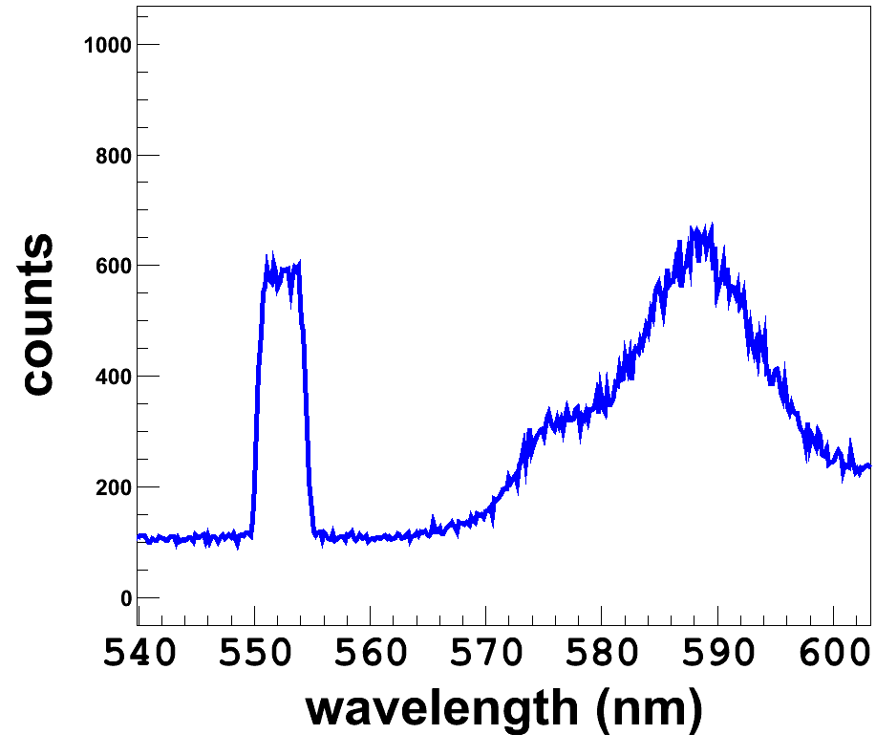
Barium in solid xenon
laser
main fluorescence
filter cut-off
6s6p ¹P₁
590 nm
555 nm
6s5d ¹D₂
6s5d ³D_{1,2}
6s² ¹S₀

Slide 34
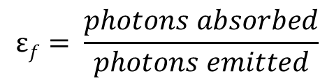
Barium in vacuum
Interactions with neighboring host atoms (xenon)
6s6p ¹P₁
553.5 nm
6s5d ¹D₂
6s5d ³D_{1,2}
6s² ¹S₀
Non-radiative decays
Out of P-state will cause decrease in fluorescence efficiency:
Out of D-states can help re-populate ground state
$$εf= \frac{photons absorbed}{photons emitted}$$
* Forbidden decays can become stronger in a solid matrix, e.g., parity-forbidden D -> S decay in barium
Decay rates can be different from vacuum values, affecting fluorescence vs. time

Slide 35
(side view)
Ba atoms
solid xenon
sapphire
window
laser
n = 1.77
Focusing the laser effectively reduces number of atoms being observed.

Slide 36
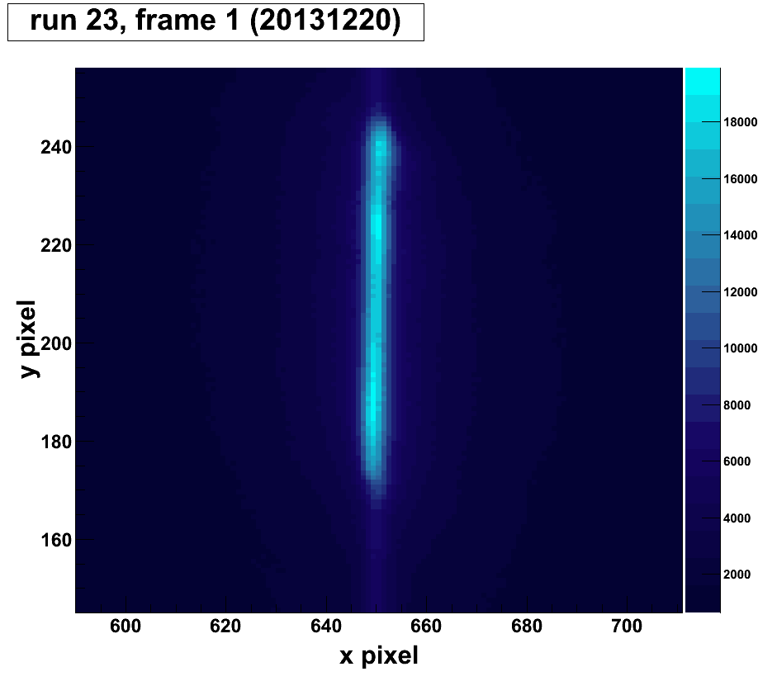
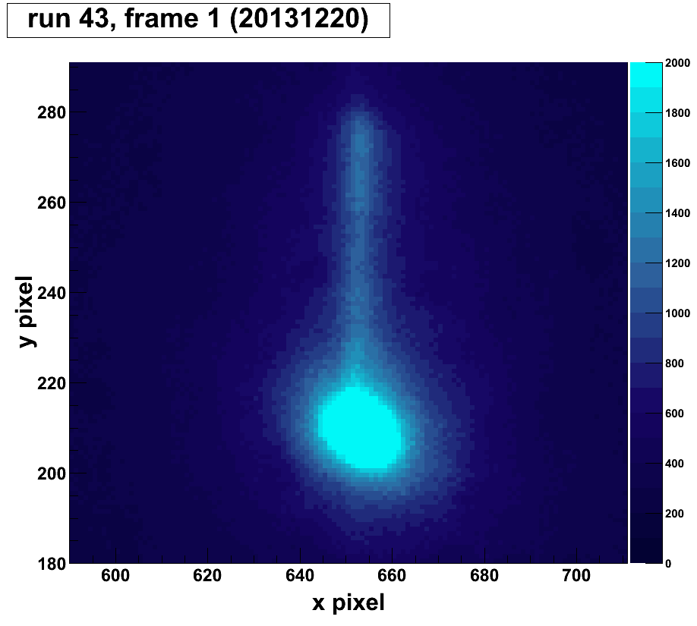
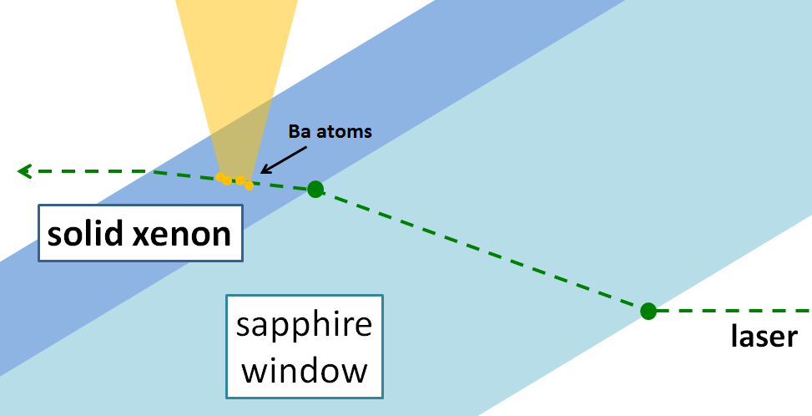
Imaging
No deposit
(window-only)
(from above)
w/ ion deposit
Window width
See fluorescence on window’s top surface
(side view)

Slide 37
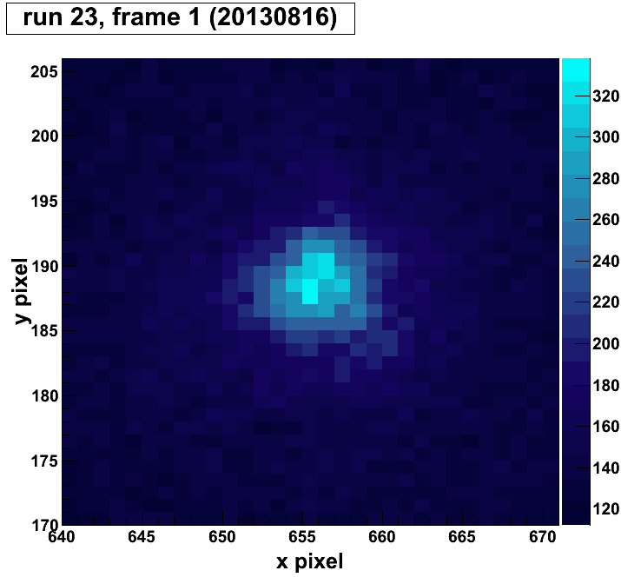






Barium Fluorescence Images
w/ focused laser
50 msec.
100 msec.
200 msec.
700 msec.
~4.5 sec.
~3 min.
Cross-section
at focus position:
Too much optical pumping to detect signal from 1 atom

Slide 38


Optical pumping of Ba
Rate Equation
$\frac{dN1}{dt}=−W12$N₁ + A₂₁N₂ + A₃₁N₃ + A₄₁N₄ + A₅₁N₅
$\frac{dN2}{dt}=W12$N₁ – (A₂₁ + A₂₃ + A₂₄ + A₂₅) N₂
$\frac{dN3}{dt}=$A₂₃N₂ – A₃₁N₃
$\frac{dN4}{dt}=$A₂₄N₂ – A₄₁N₄
$\frac{dN5}{dt}=$A₂₅N₂ – A₅₁N₅
N₁ + N₂ + N₃ + N₄ + N₅ = N_{atoms}
2
6s6p
A_{2(3,4,5)}
W₁₂
3
4
6s5d
A₂₁
5
A_{(3,4,5)1}
1
6s²
Rates in vacuum:
A₂₁=1.2x10⁸ s⁻¹
A₂₃=2.5x10⁵ s⁻¹
A₂₄=1.1x10⁵ s⁻¹ branching ratio 0.003
A₂₅=3.1x10³ s⁻¹
A₃₁=5 s⁻¹
A₄₁=0.014 s⁻¹ very slow metastable decay
A₅₁=0.017 s⁻¹
model
Total fluorescence photons

Slide 39

Overcoming optical pumping with re-pump lasers
Rate Equation w/ re-pumps
2
W_{(3,4,5)2}
W₁₂
A_{2(3,4,5)}
3
4
A₂₁
5
A_{(3,4,5)1}
1
model
With 3 re-pump lasers, fluorescence does not saturate.
Total fluorescence photons

Slide 40
Ba MOT produced in vacuum
Two effective re-pumping schemes demonstrated for MOT
De et al., PHYSICAL REVIEW A 79 (2009)
1500.0 nm,
1130.3 nm
5d6p ³D₁º
6s6p ¹P₁
1500.0 nm,
1107.6 nm,
1130.3 nm
(others)
659.7 nm
6s5d ¹D₂
6s5d ³D₂
6s5d ³D₁
6s² ¹S₀
(ground)
(ground)
~10⁷ photons/sec achieved
We expect similar excitation rate for a focused laser with Ba in SXe.

Slide 41
Plan for this Thesis:
Understand matrix effects on barium fluorescence rates
Overcome optical pumping to achieve high counts/atom
Image single atoms

Slide 42


Understand matrix effects on barium fluorescence rates
Focused laser optically pumps too fast
use less (or no) laser focus:
more uniform laser intensity --> known excitation rate (w₁₂)
lower laser intensity --> slower optical pumping
larger area --> more atoms --> more signal on short time scales
Fluorescence Decay at Different Laser Intensities:
Compare to model to determine matrix-induced decay rates.

Slide 43
2) Overcome optical pumping
sample
dye laser
555nm
Absorption can be broadened in SXe
-> first tried convenient
lasers near vacuum re-
pump wavelengths:
1064nm
laser
1550nm
laser diode
dichroic filters
1550nm to re-pump 1500.0nm (vacuum) line
-and-
1064nm to re-pump both
1107.6nm and 1130.3nm (vacuum) lines
6s6p ¹P₁
6s5d ¹D₂
6s5d ³D₂
6s5d ³D₁
6s² ¹S₀
(ground)

Slide 44


Results from convenient re-pump search
Each curve is a separate deposit
Integrated fluorescence counts
*this needs to be repeated/confirmed
Looks like off-resonant/incomplete re-pump.
Model comparisons will help inform which re-pump(s) are needed, especially desired since more expensive lasers will be needed.

Slide 45



3) Image single atoms!
Image of 3 dye molecules in SXe:
Since more focused laser will be required,
imaging will require sufficient
Optical resolution vs. density of ion deposit
Collection efficiency vs. fluorescence rate
May need to improve some elements:
Collection optics:
Cold finger
clamps
Ion source:
Barium fluorescence
Low-rate Ba⁺ source
w/ alpha-recoil counter
SXe laser (w/ Ba)
* better ion count will help determine tagging efficiency/neutralization %
* will also require bypassing spectrometer

Slide 46


Ion Extraction from Liquid Xenon
Currently underway in parallel, by Chris Chambers and Adam Craycraft
Cold Probe
Barium Source
Liquid Xenon Cell
Cold Probe

Slide 47
conclusions
Summarized study of neutrinos by neutrinoless double beta decay in EXO
We have made a lot of progress toward understanding barium fluorescence in solid xenon, with remaining tasks:
Understanding rate changes in SXe
Overcoming optical pumping
Imaging single atoms

Slide 48


extra stuff

